Slide 1
Session Plan
First half
Lecture recap
Activity 1: Card game 1
Activity 2: Card game 2
Activity 3: Bring me news
Second half
Group discussion (work sheet 6)
Recap: Learning logs

Slide 2
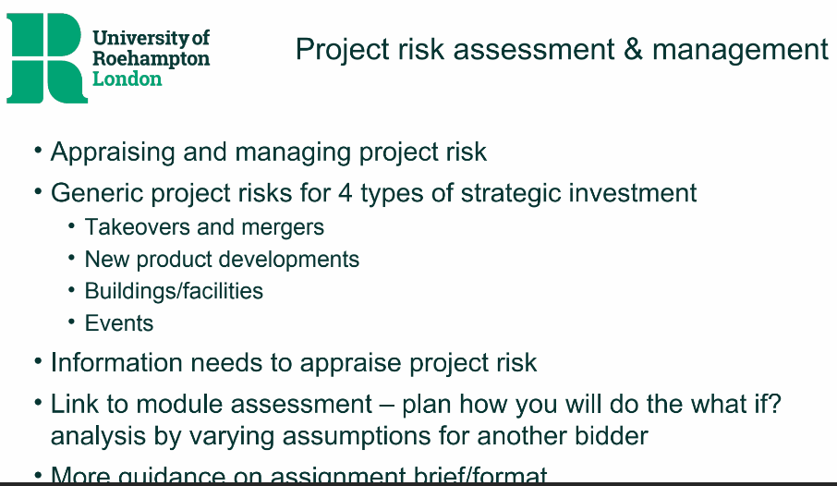
Lecture Recap

Slide 3

Seminar Activity – share & apply Card game 6.1
Card game: It is a way to randomize case examples to discuss. Throughout the module, we call it card game.
The card will show the name of a well-known project (google it if it is unfamiliar)
Answer the following questions:
What are the main risks involved?
How might these project risks be mitigated?
How might any additional project risk arising from cross-border issues be mitigated?

Slide 4


Card game 6.1 – Risk Card = King of spades Scenario = Building of the Channel Tunnel
K
K

Slide 5
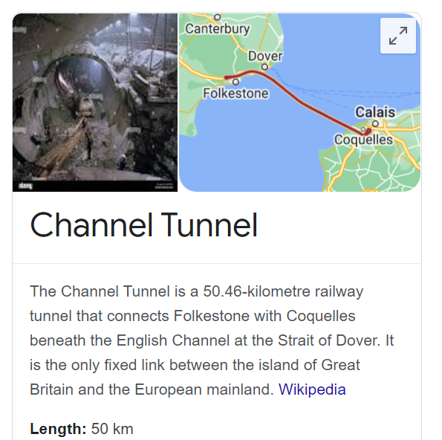
What are the main risks involved?
How might these project risks be mitigated?
How might any additional project risk arising from cross-border issues be mitigated?
6.1 Building of the Channel Tunnel
Generic risks: leadership & project management; workforce (availability, skill, motivation); continuity (if relocating operations); timing: to open on time. What if the project ran out of money?
Specific risks: Political risk? Safety risk?
Expertise to be bought in; better working environment and reward system; budgetary control
Planned escape routes and safety procedures
Clear division of responsibilities and good project management/leadership
Unified source of materials/labour (supply chain management)
Notes:
Comparing Budget with Actual: Variance analysis helps in managing the annual budgets by monitoring the budgeted figures and comparing it with the actual revenue/cost.

Slide 6
Card game 6.2 – Risk Card = Ace of spades Scenario = Heathrow terminal 5
A
A

Slide 7
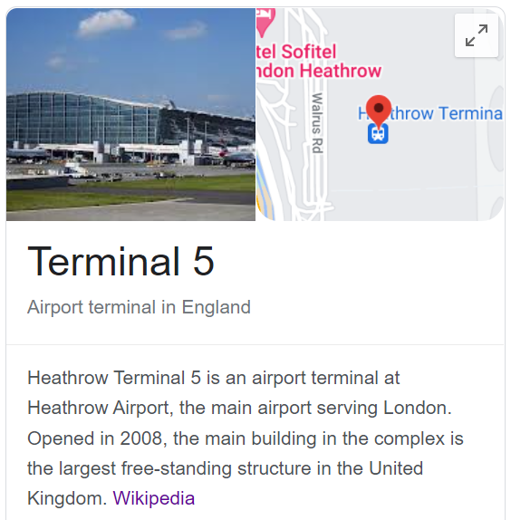
What are the main risks involved?
How might these project risks be mitigated?
How might any additional project risk arising from cross-border issues be mitigated?
Generic risks: Refer the Channel Tunnel case
Specific risks: existing environment (logistics of construction near an operating airport and considerations of environmental impact - ); additional construction (road link)
Specific risks: Contractual obligations signed
Consideration of differences in government policies
Dual pricing policy/currency
Consideration of language & cultural differences
(Refer the Channel Tunnel case)
6.1 Building Heathrow Terminal 5
Notes:
Generic risks poor leadership & project management; availability of skilled workforce; motivation of workforce; continuity (if relocating operations); capacity & planned usage; engineering/design quality; timing: to open on time. What if the project ran out of money?

Slide 8

Seminar activity – Bring me news
Pre-seminar:
What firm/organisation has been in the business news this week &why?
During the seminar:
What type of project does the news relate to?
In/after the seminar:
How can I learn from this to enhance my knowledge of SIA and/or for ass’t?

Slide 9
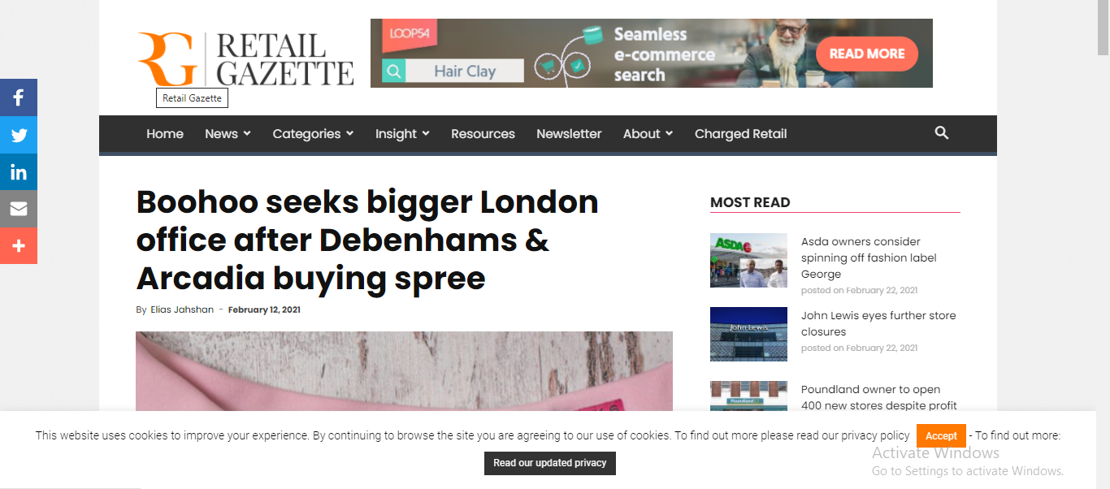
Bring me news - Boohoo

Slide 10
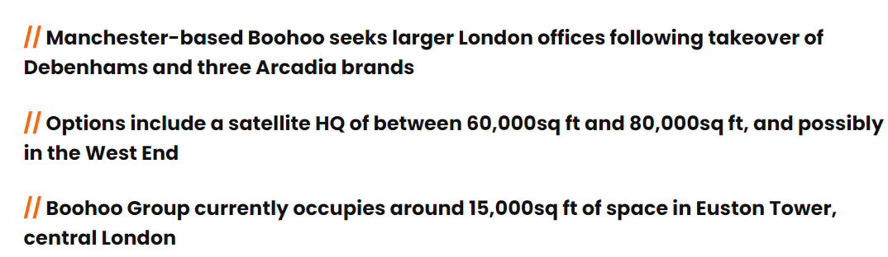
News: Boohoo seeks bigger office post Debenhams acq

Slide 11
Decision-making context e.g.
Boohoo seeks bigger office post Debenhams acq
SIA context
Business Model
Business ownership/ history
Market/ trading conditions
Industry norms/ benchmarks
5. How does this shape the decision context?
1. What does the organisation do to create value?
Boohoo need more office space to house on-line operations and expand HQ
Boohoo - On-line fashion retail (Buys commodity from manufacturers to sell online, need to hold inventory)
2. Who owns the enterprise & how has it developed?
The Boohoo Group is owned by co-founder, billionaire British businessman Mahmud Kamani
4. What are the current industry expectations?
More high street stores will close permanently & on-line sales will continue to grow, or high street stores will come back post covid..?
3. What is the business environment/ competitive situation?
Retail stores closed for much of last 24 months due to the pandemic, while on-line market grew

Slide 12
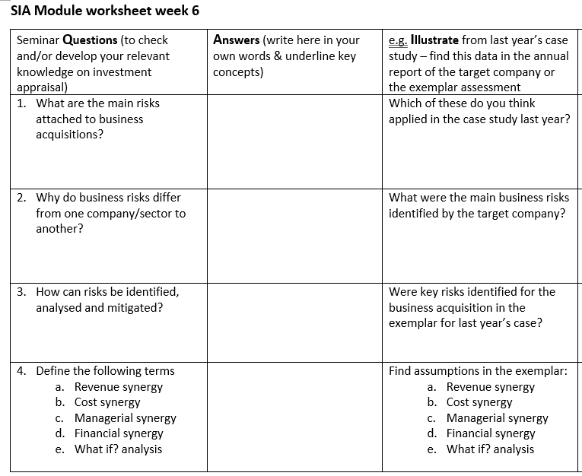
Group discussion: Worksheet 6

Slide 13
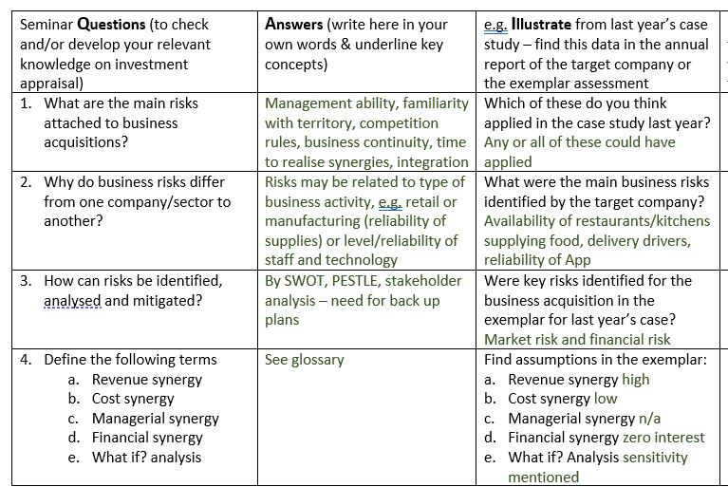
Group discussion: Worksheet 6

Slide 14
Reminder – practice a learning (b)log on Moodle
Experience
Reflection
Generalisation
Action

Slide 15


Step 1 EXPERIENCE – What did you discover?
Watch/listen to the recording of the lecture and highlight new knowledge areas for you

Slide 16
Step 2 REFLECTION – What did you find useful?
What new knowledge did you apply to specific examples and what new skills did you learn from participating in the seminar that might be useful to practice again?

Slide 17
Step 3 GENERALISATION – Key learning points?
What were the general learning points that might apply to any strategic investment decisions?

Slide 18
Step 4 ACTION – How will I apply this to the assignment?
Which assessment task does this learning relate to and how might I apply to the assigned case study?

Slide 19

Any questions? (on activities or the assessment brief)

